Slide 1
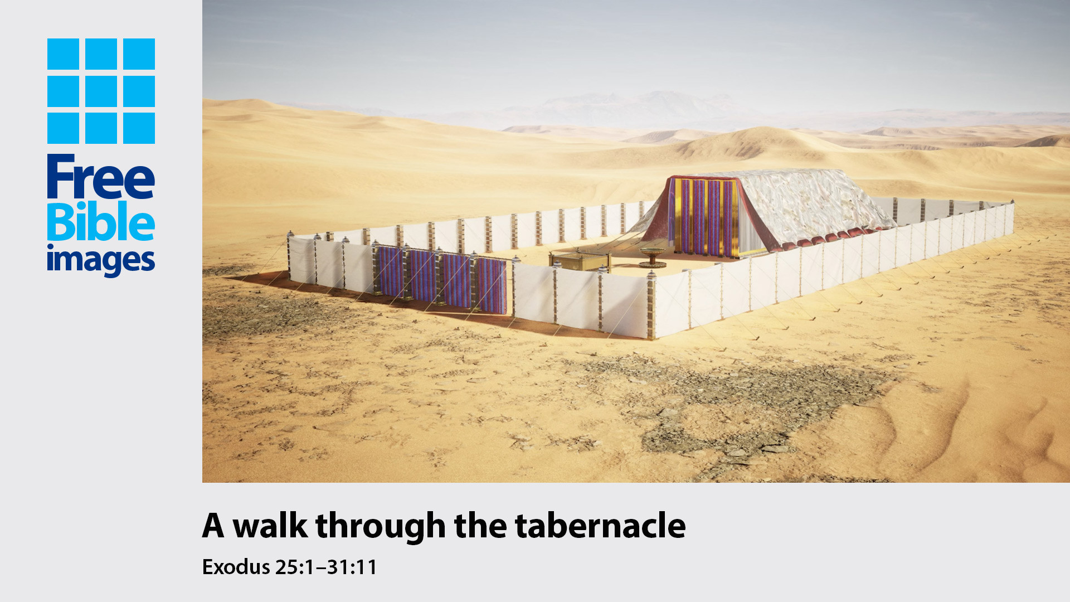

Slide 2
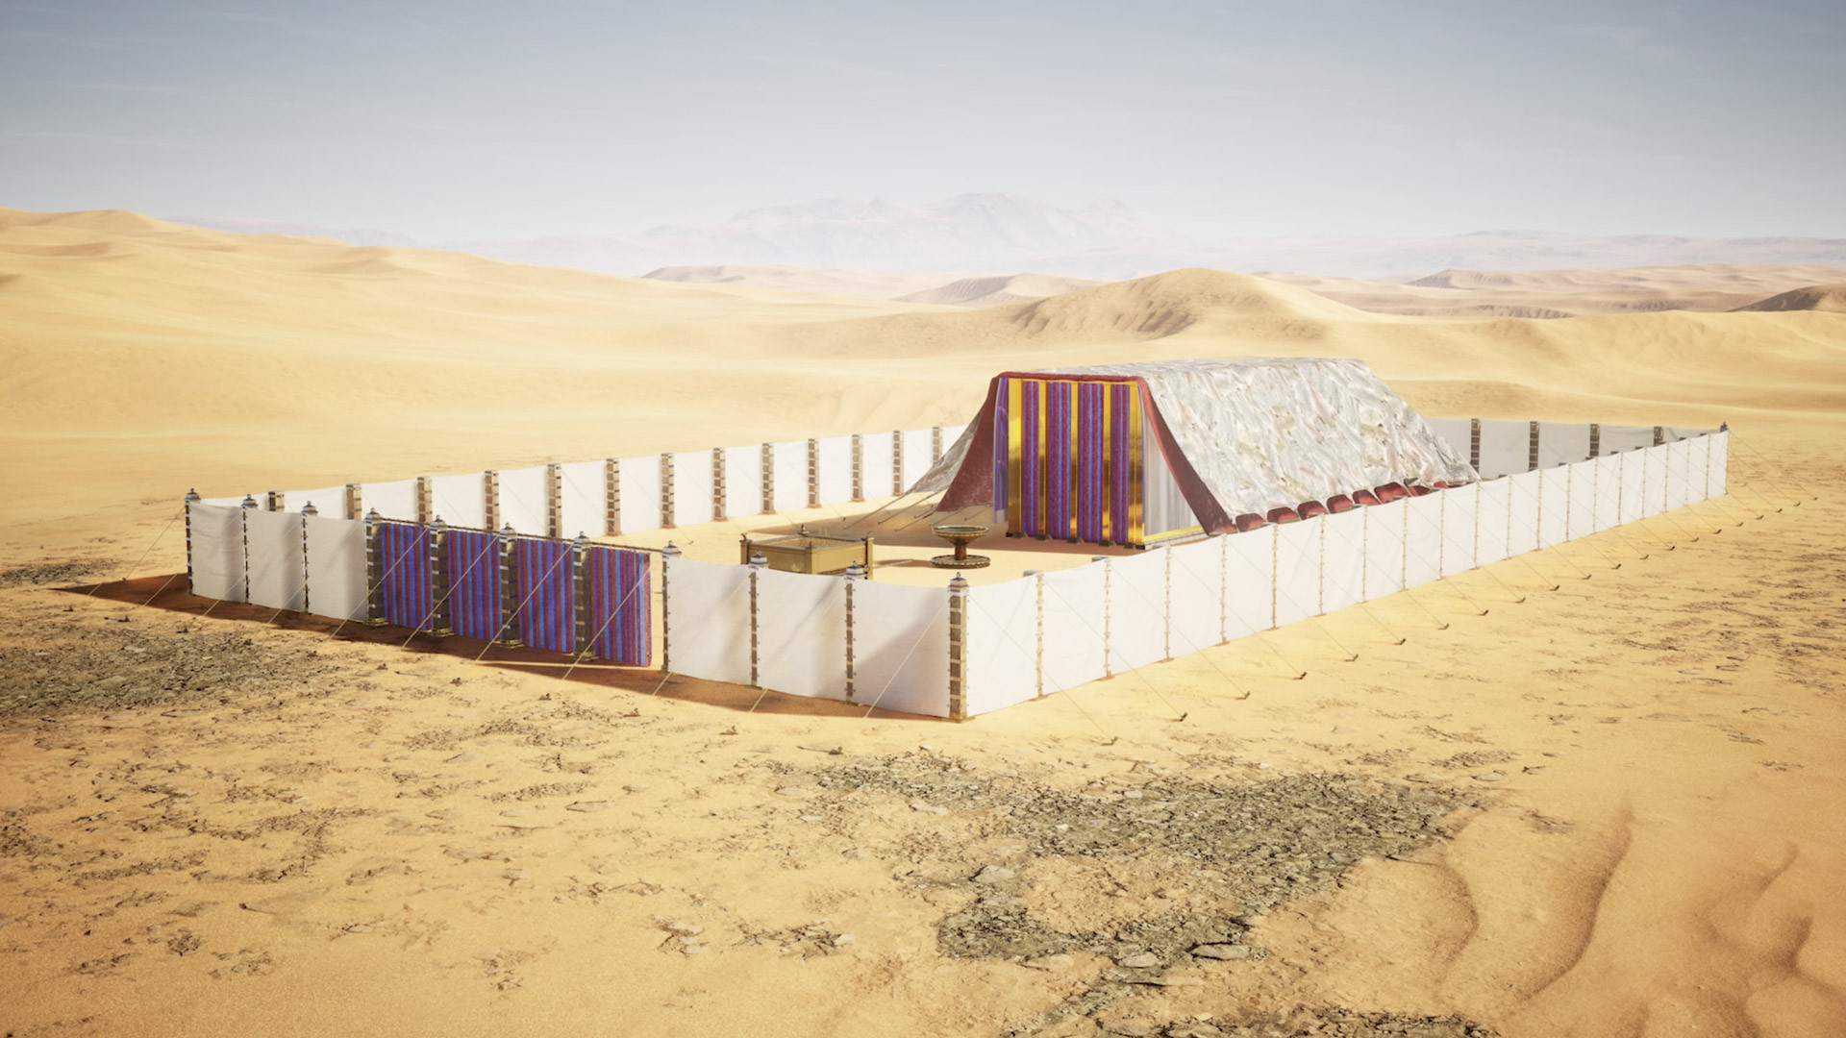
Notes:
The Tabernacle was pitched facing the east, the position of the sun at sunrise.

Slide 3
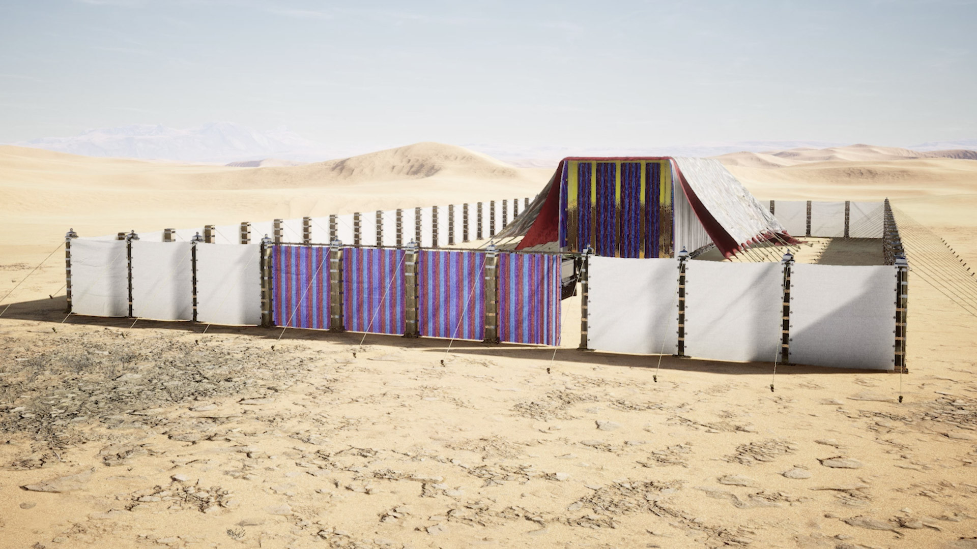
Notes:
There was only one entrance to the tabernacle called the ‘Gate of the court’.

Slide 4
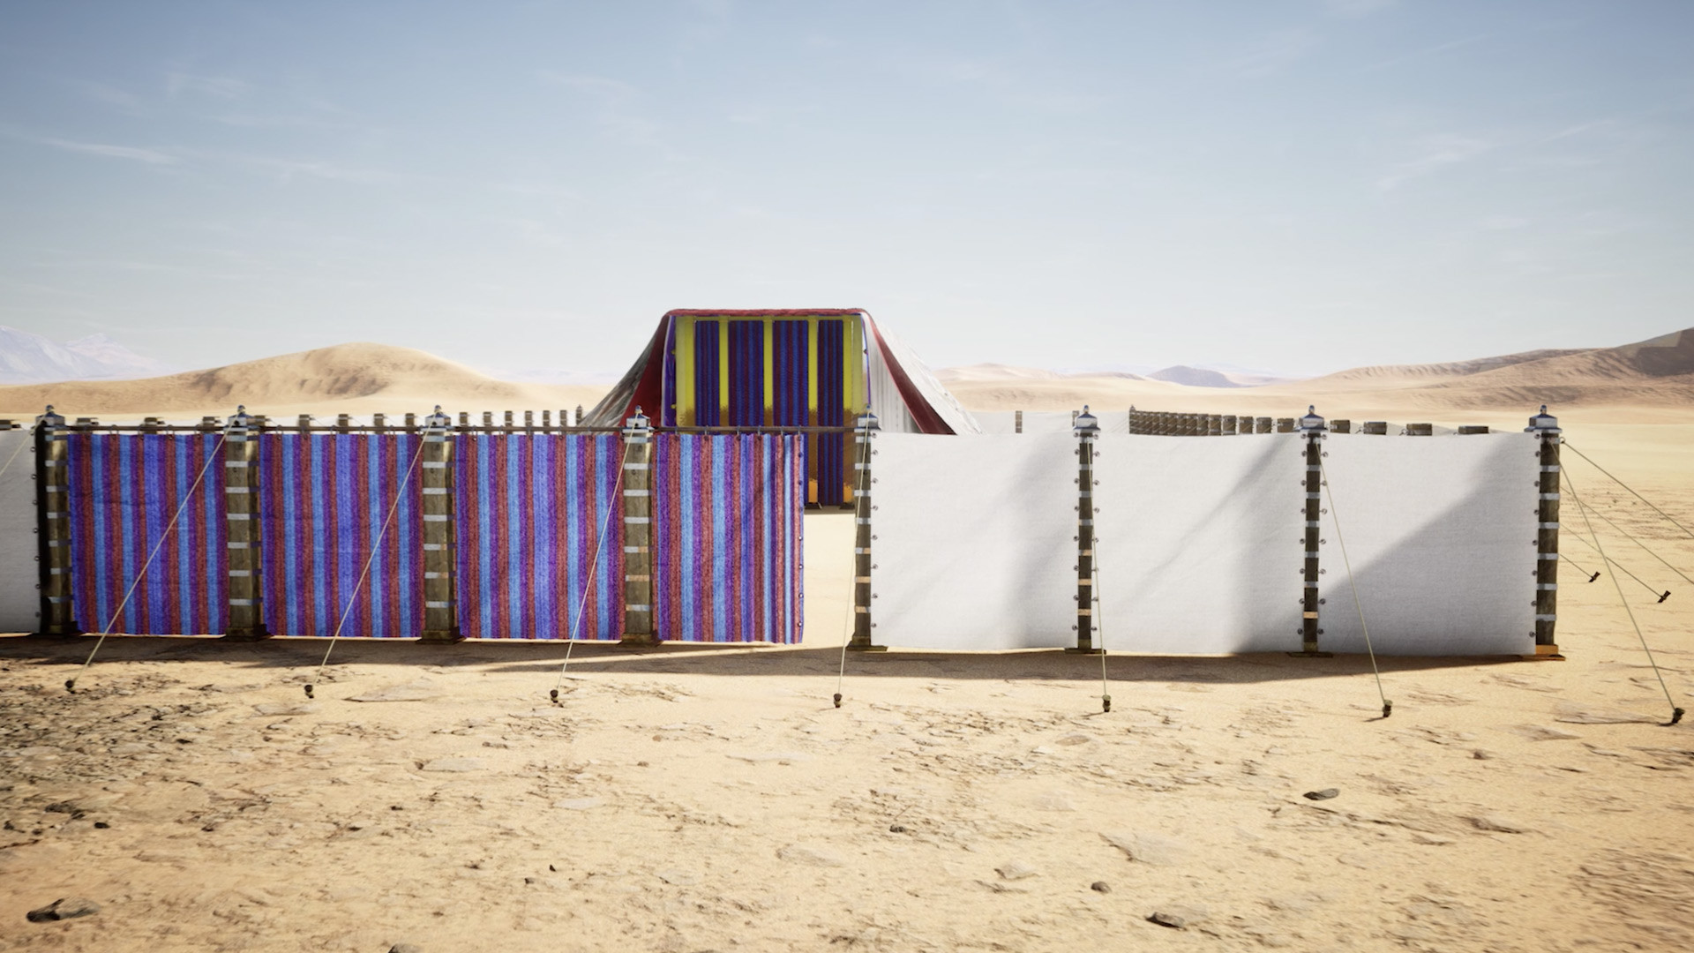
Notes:
The colours of the threads in the gate curtain were symbolic. Blue stood for the deity, meaning the court was a place of God. Purple, a difficult and expensive dye to produce, was a symbol of royalty.

Slide 5
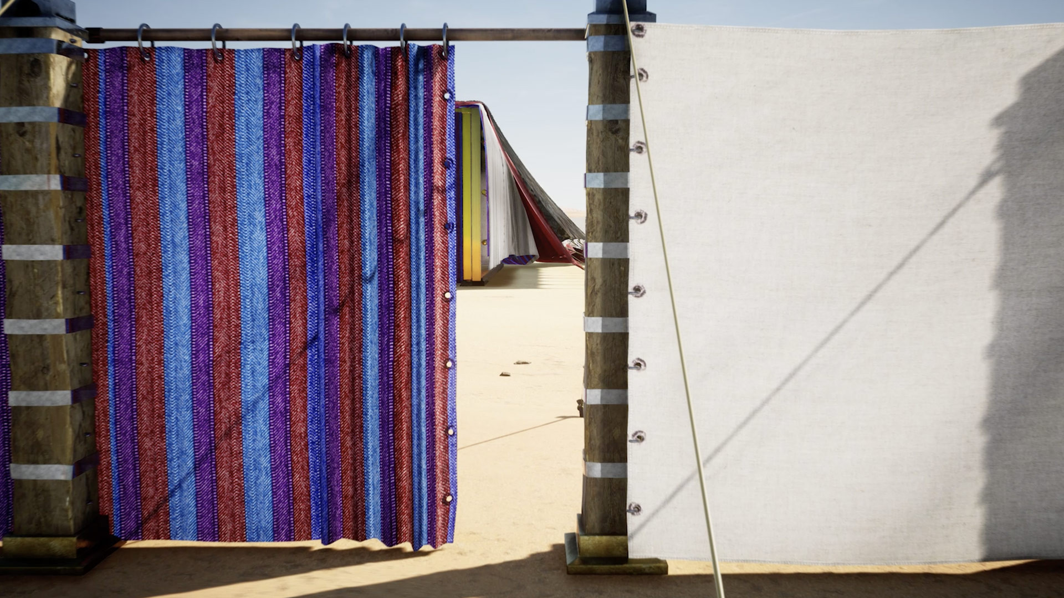
Notes:
Red symbolized blood, the colour of sacrifice. White meant holiness. The courtyard fence, made of white linen, enclosed holy ground, and the priests wore white linen garments.

Slide 6
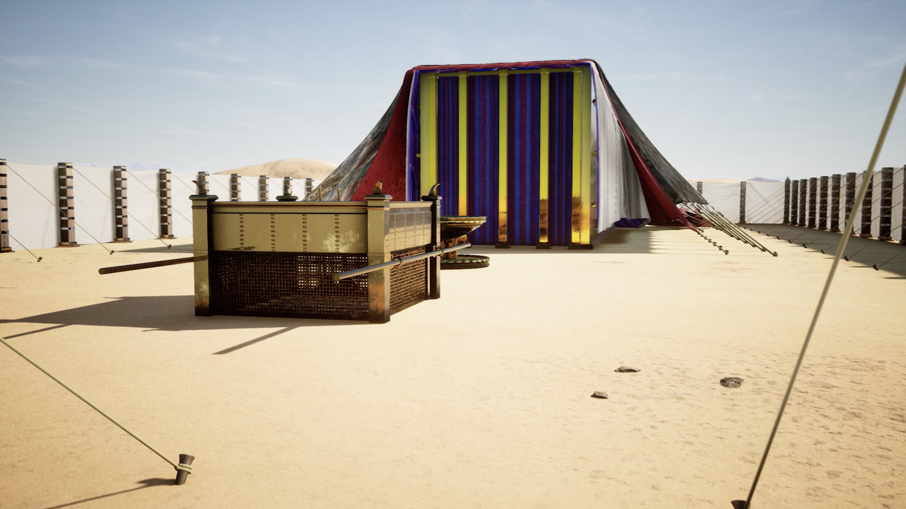
Notes:
Directly upon entering the outer court you would see the brazen altar (also called the altar of burnt offering). The Israelites made daily sacrifices to God on this altar to atone for their sin (Exodus 29:38).

Slide 7
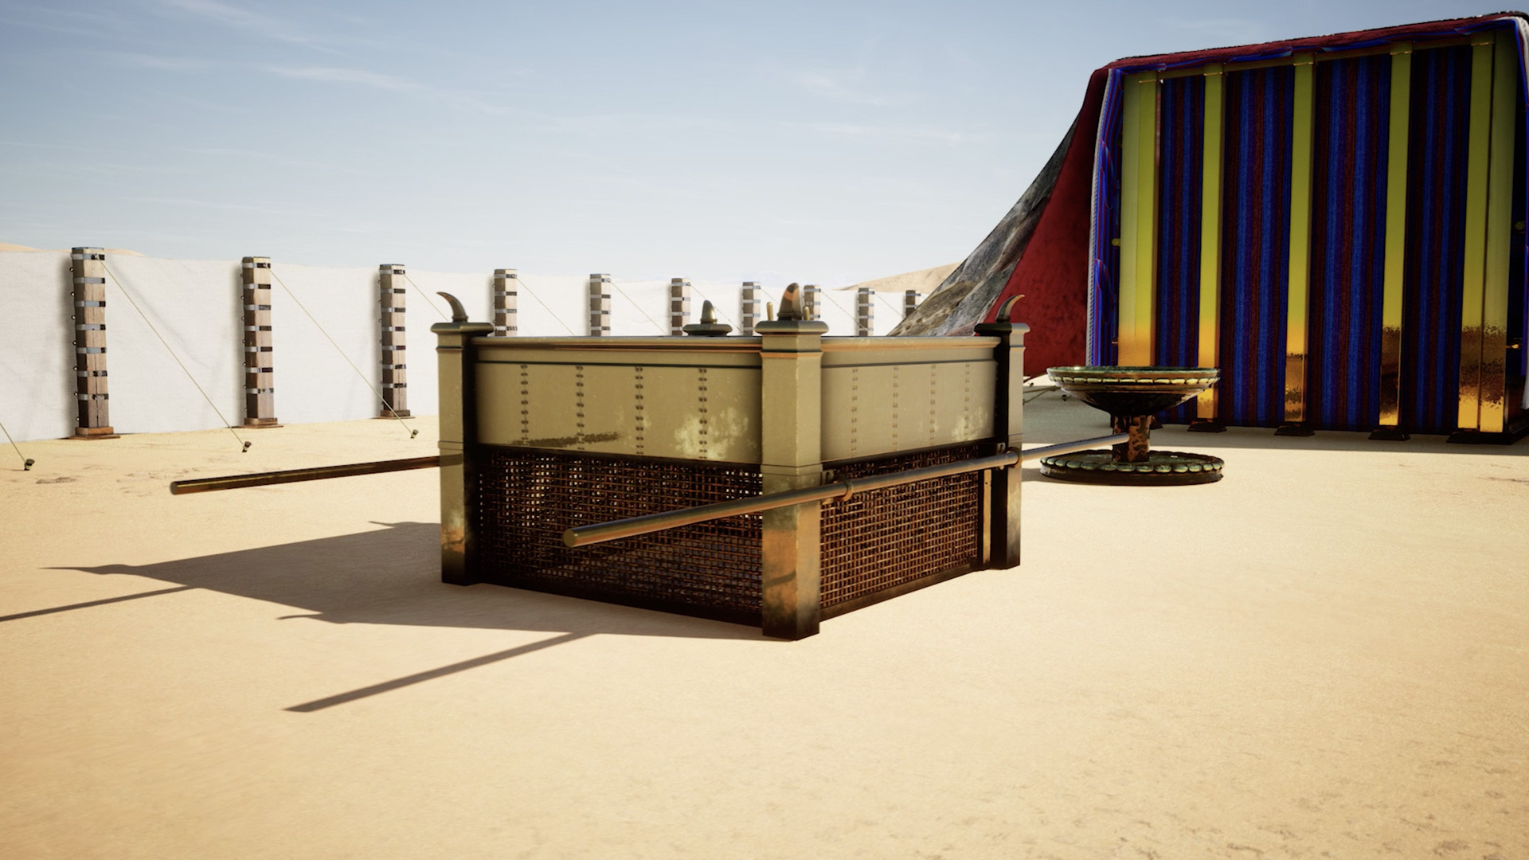
Notes:
As the first priests began their service at the tabernacle, fire from the presence of the Lord consumed the sacrifice (Leviticus 9:24). This fire of the altar was to be kept burning at all times. The horns of the altar were to be covered with blood at the consecration of the priests.

Slide 8
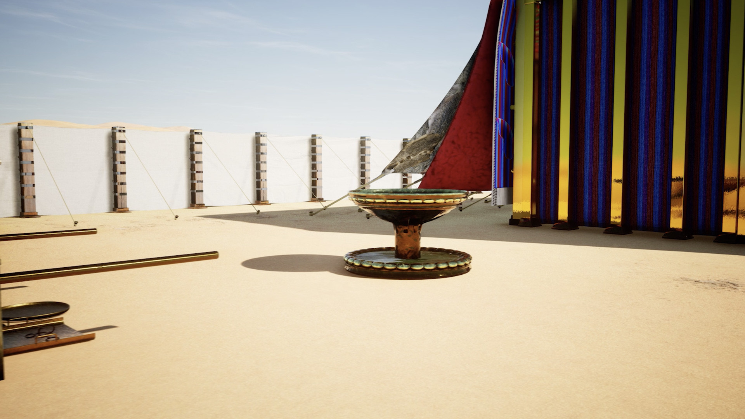
Notes:
Between the altar and the entrance to the Holy Place was a wash basin called a ‘laver’ This was where the priests had to wash themselves ceremonially so as to be consecrated or set apart for ministry.

Slide 9
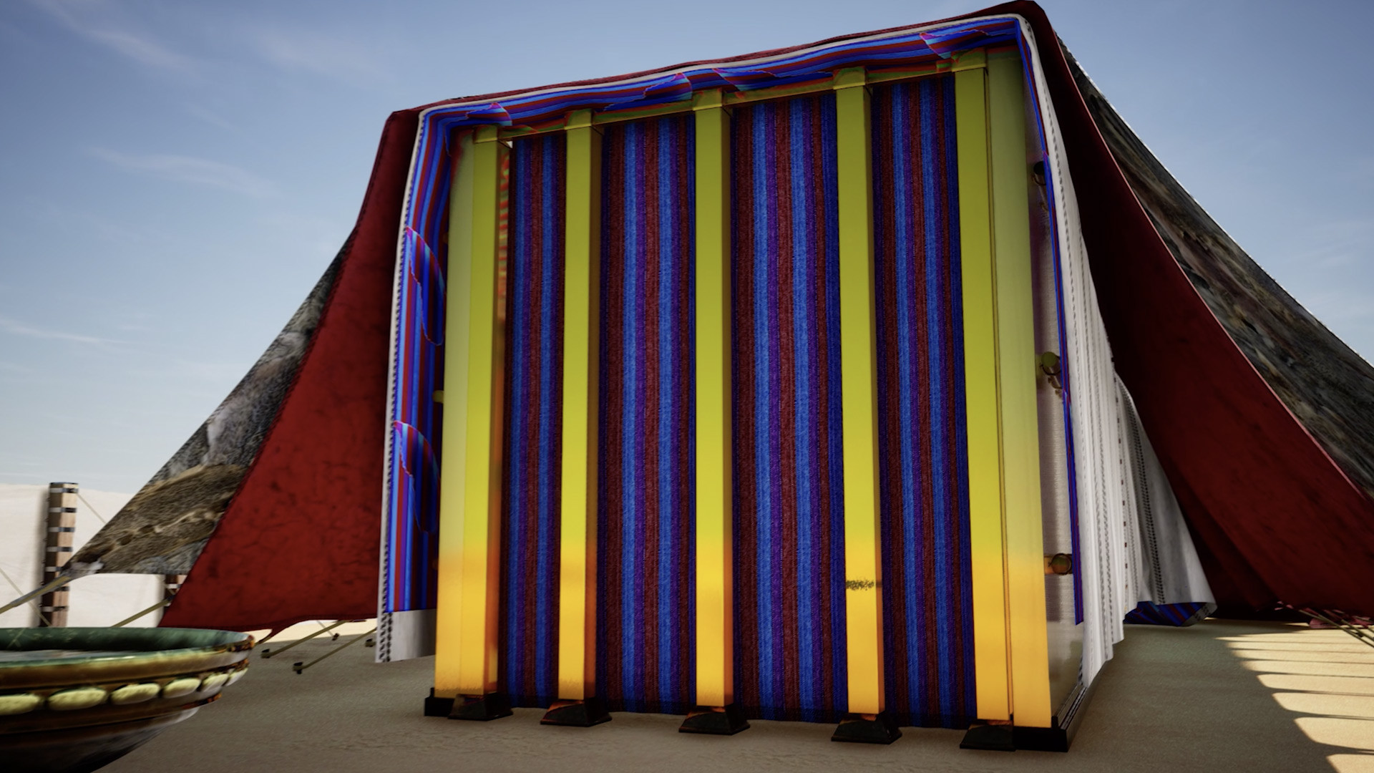
Notes:
A curtain covered the entrance to the Holy Place.

Slide 10
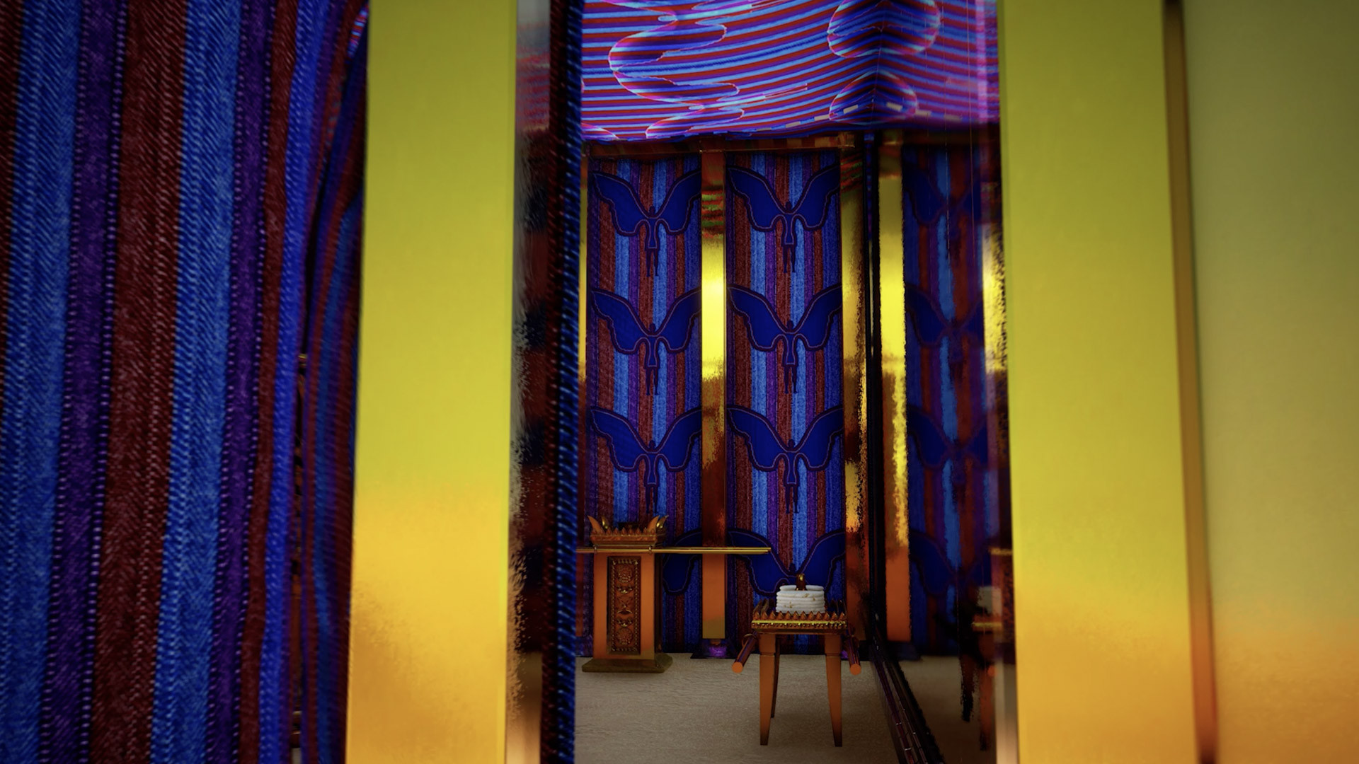
Notes:
Only priests could enter the Holy Place where there were three items. To the right was the Table of Showbread and ahead was the Altar of Incense. To the left was the Golden Lampstand.

Slide 11
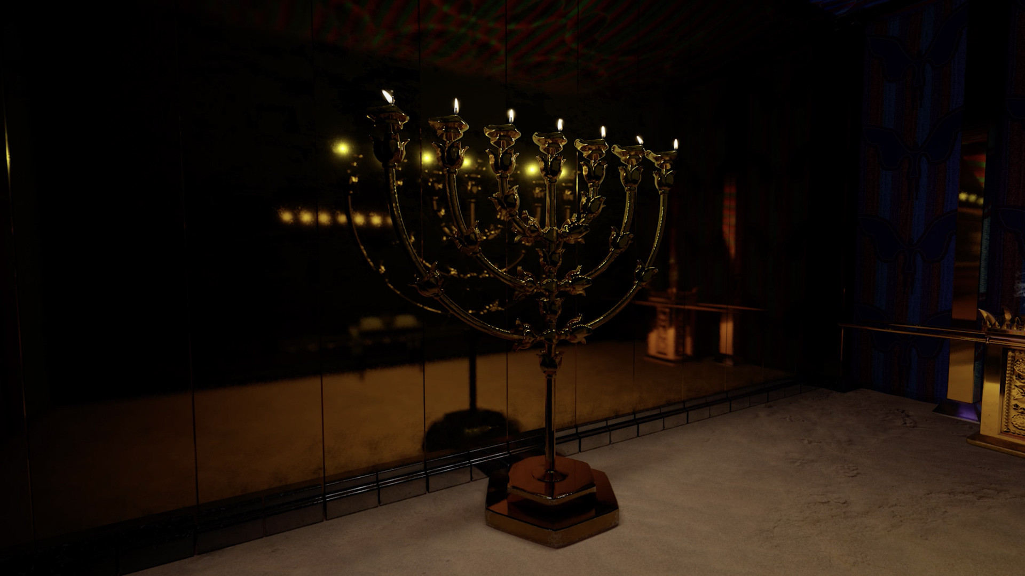
Notes:
The Golden Lampstand was fashioned as a tree with the base and middle shaft representing the trunk and with three ‘branches’ on each side. The lamp was to be tended by Aaron and his sons so that its light never went out.

Slide 12
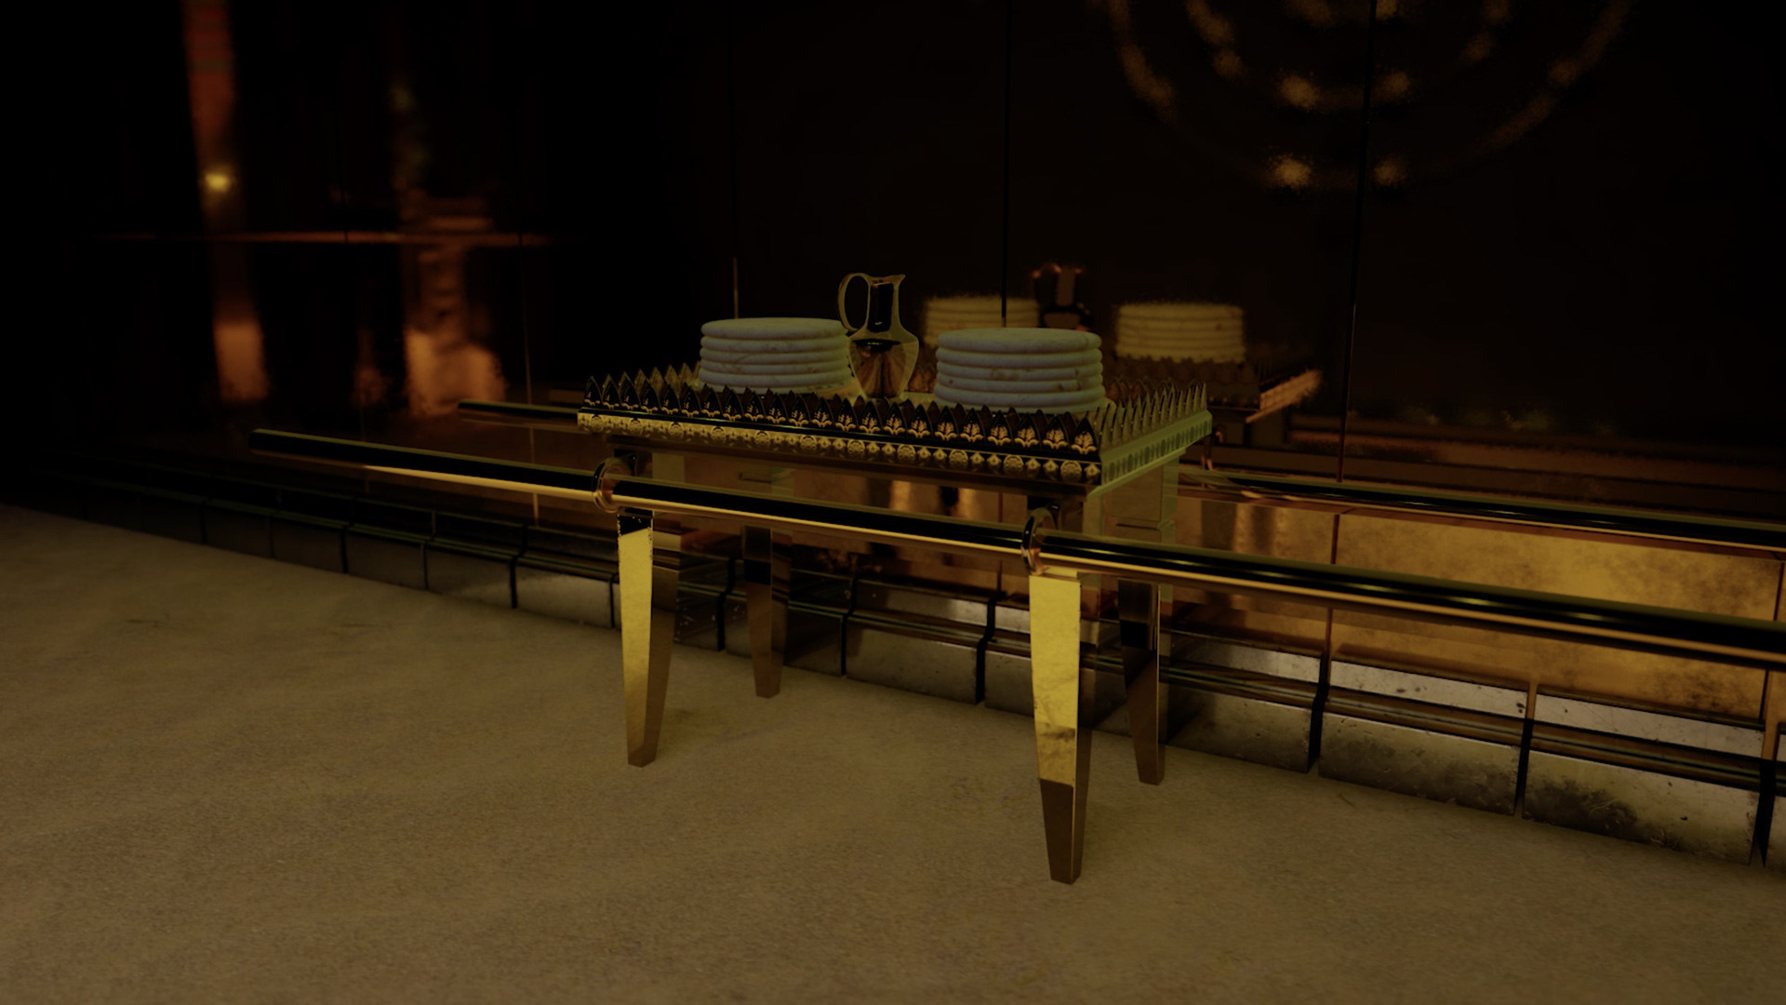
Notes:
At the start of each week the priests placed 12 loaves of fresh bread on the Table of Showbread — one for each of the 12 tribes. It served as a memorial food offering to the Lord.

Slide 13
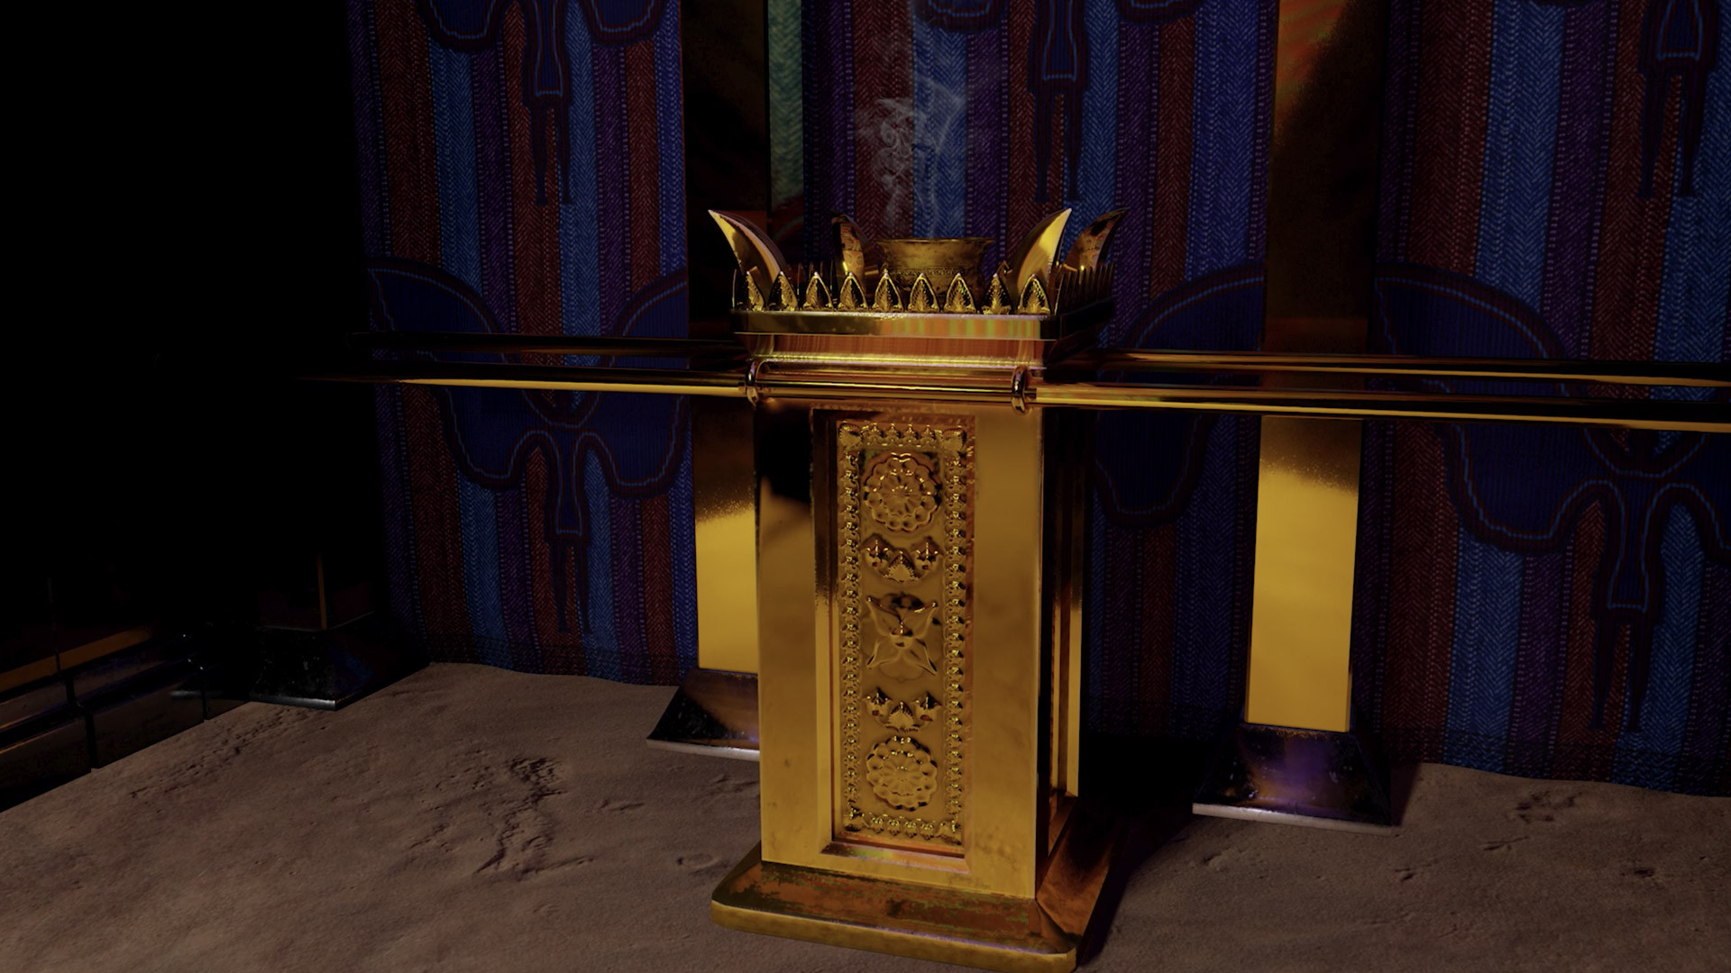
Notes:
Aaron was instructed to burn incense on the altar each morning and at twilight, every day, as a regular offering to the Lord. In Scripture, incense is often associated with prayer.

Slide 14
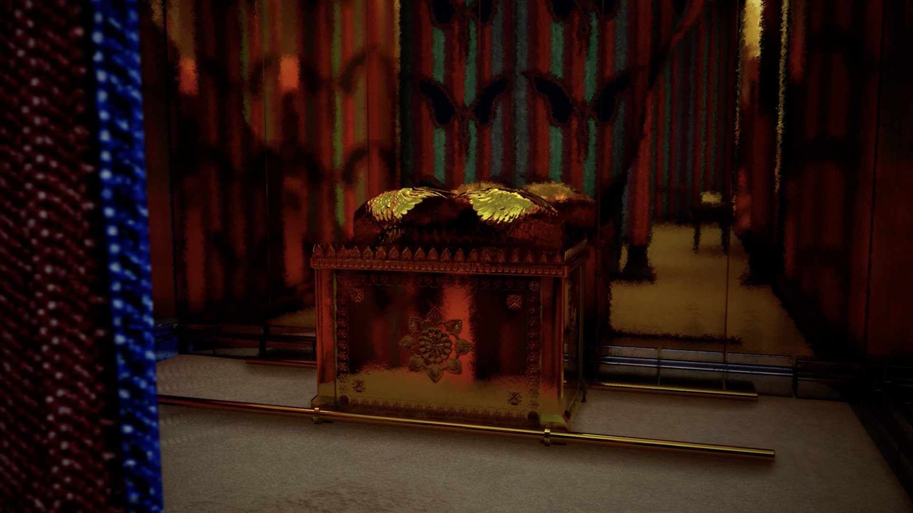
Notes:
The High Priest alone could enter through the curtain to the Holy of Holies. This was allowed once a year on the Day of Atonement. Inside was the Ark of the Covenant.

Slide 15
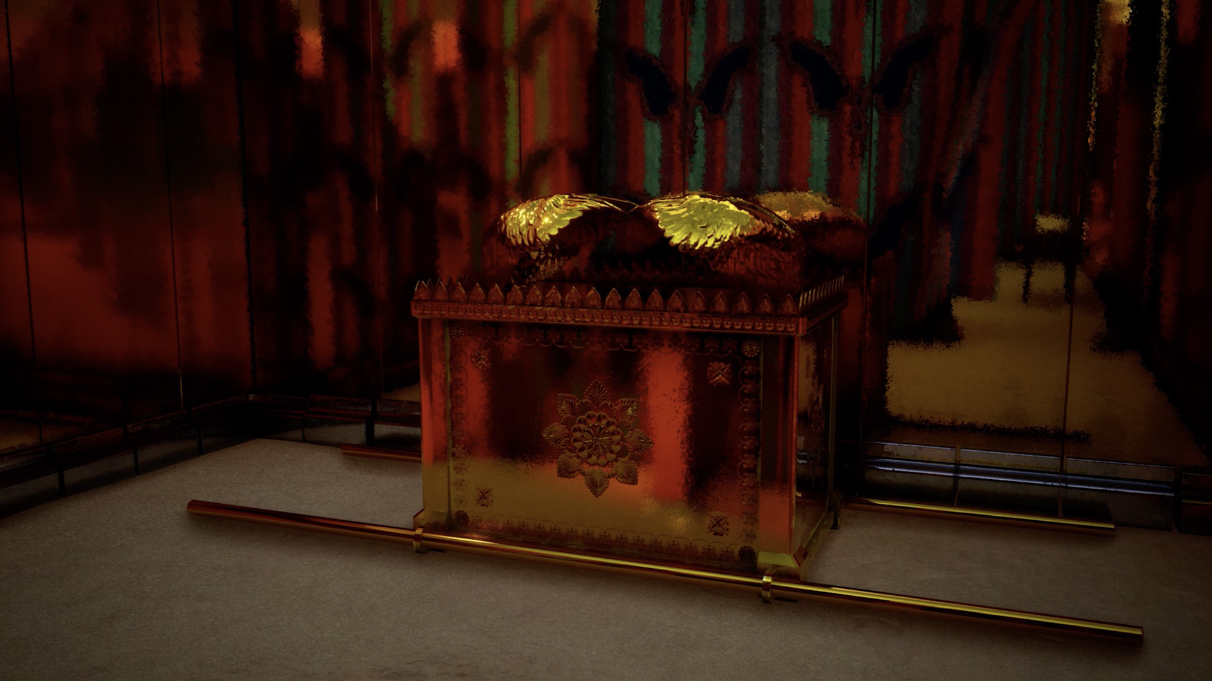
Notes:
This lid of the Ark of the covenant with the two cherubim that was placed on top was known as the mercy seat.
God is described as being enthroned between the cherubim over the ark (1 Samuel 4:4, Psalm 18:10)
Once a year the High Priest would sprinkle the blood of a bull and a goat on the mercy seat to make atonement for his own sin and the sin of the people.

Slide 16
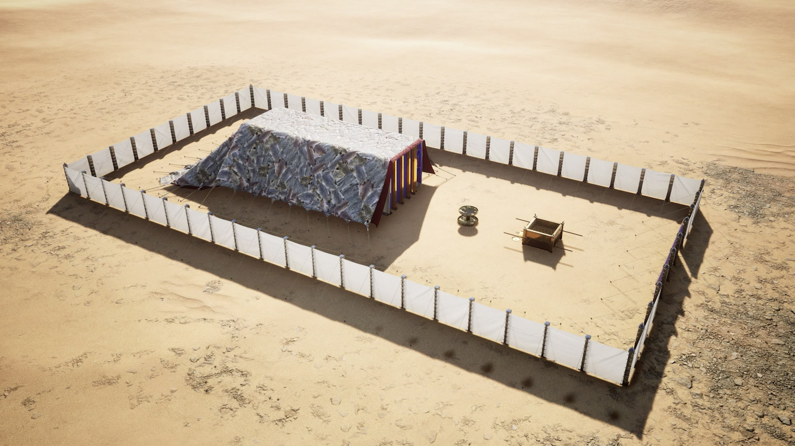
Notes:
Although the tabernacle was heavy and had many parts, it was surprisingly portable. Priests carried the Ark and the altars on their shoulders, but the rest was transported in ox-drawn carts.

Slide 17
